Slide 1
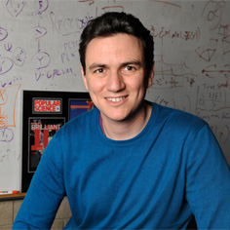
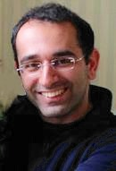
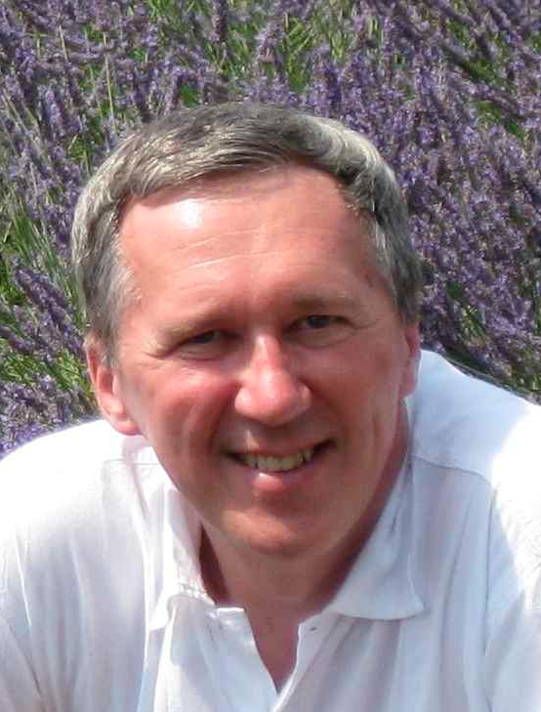
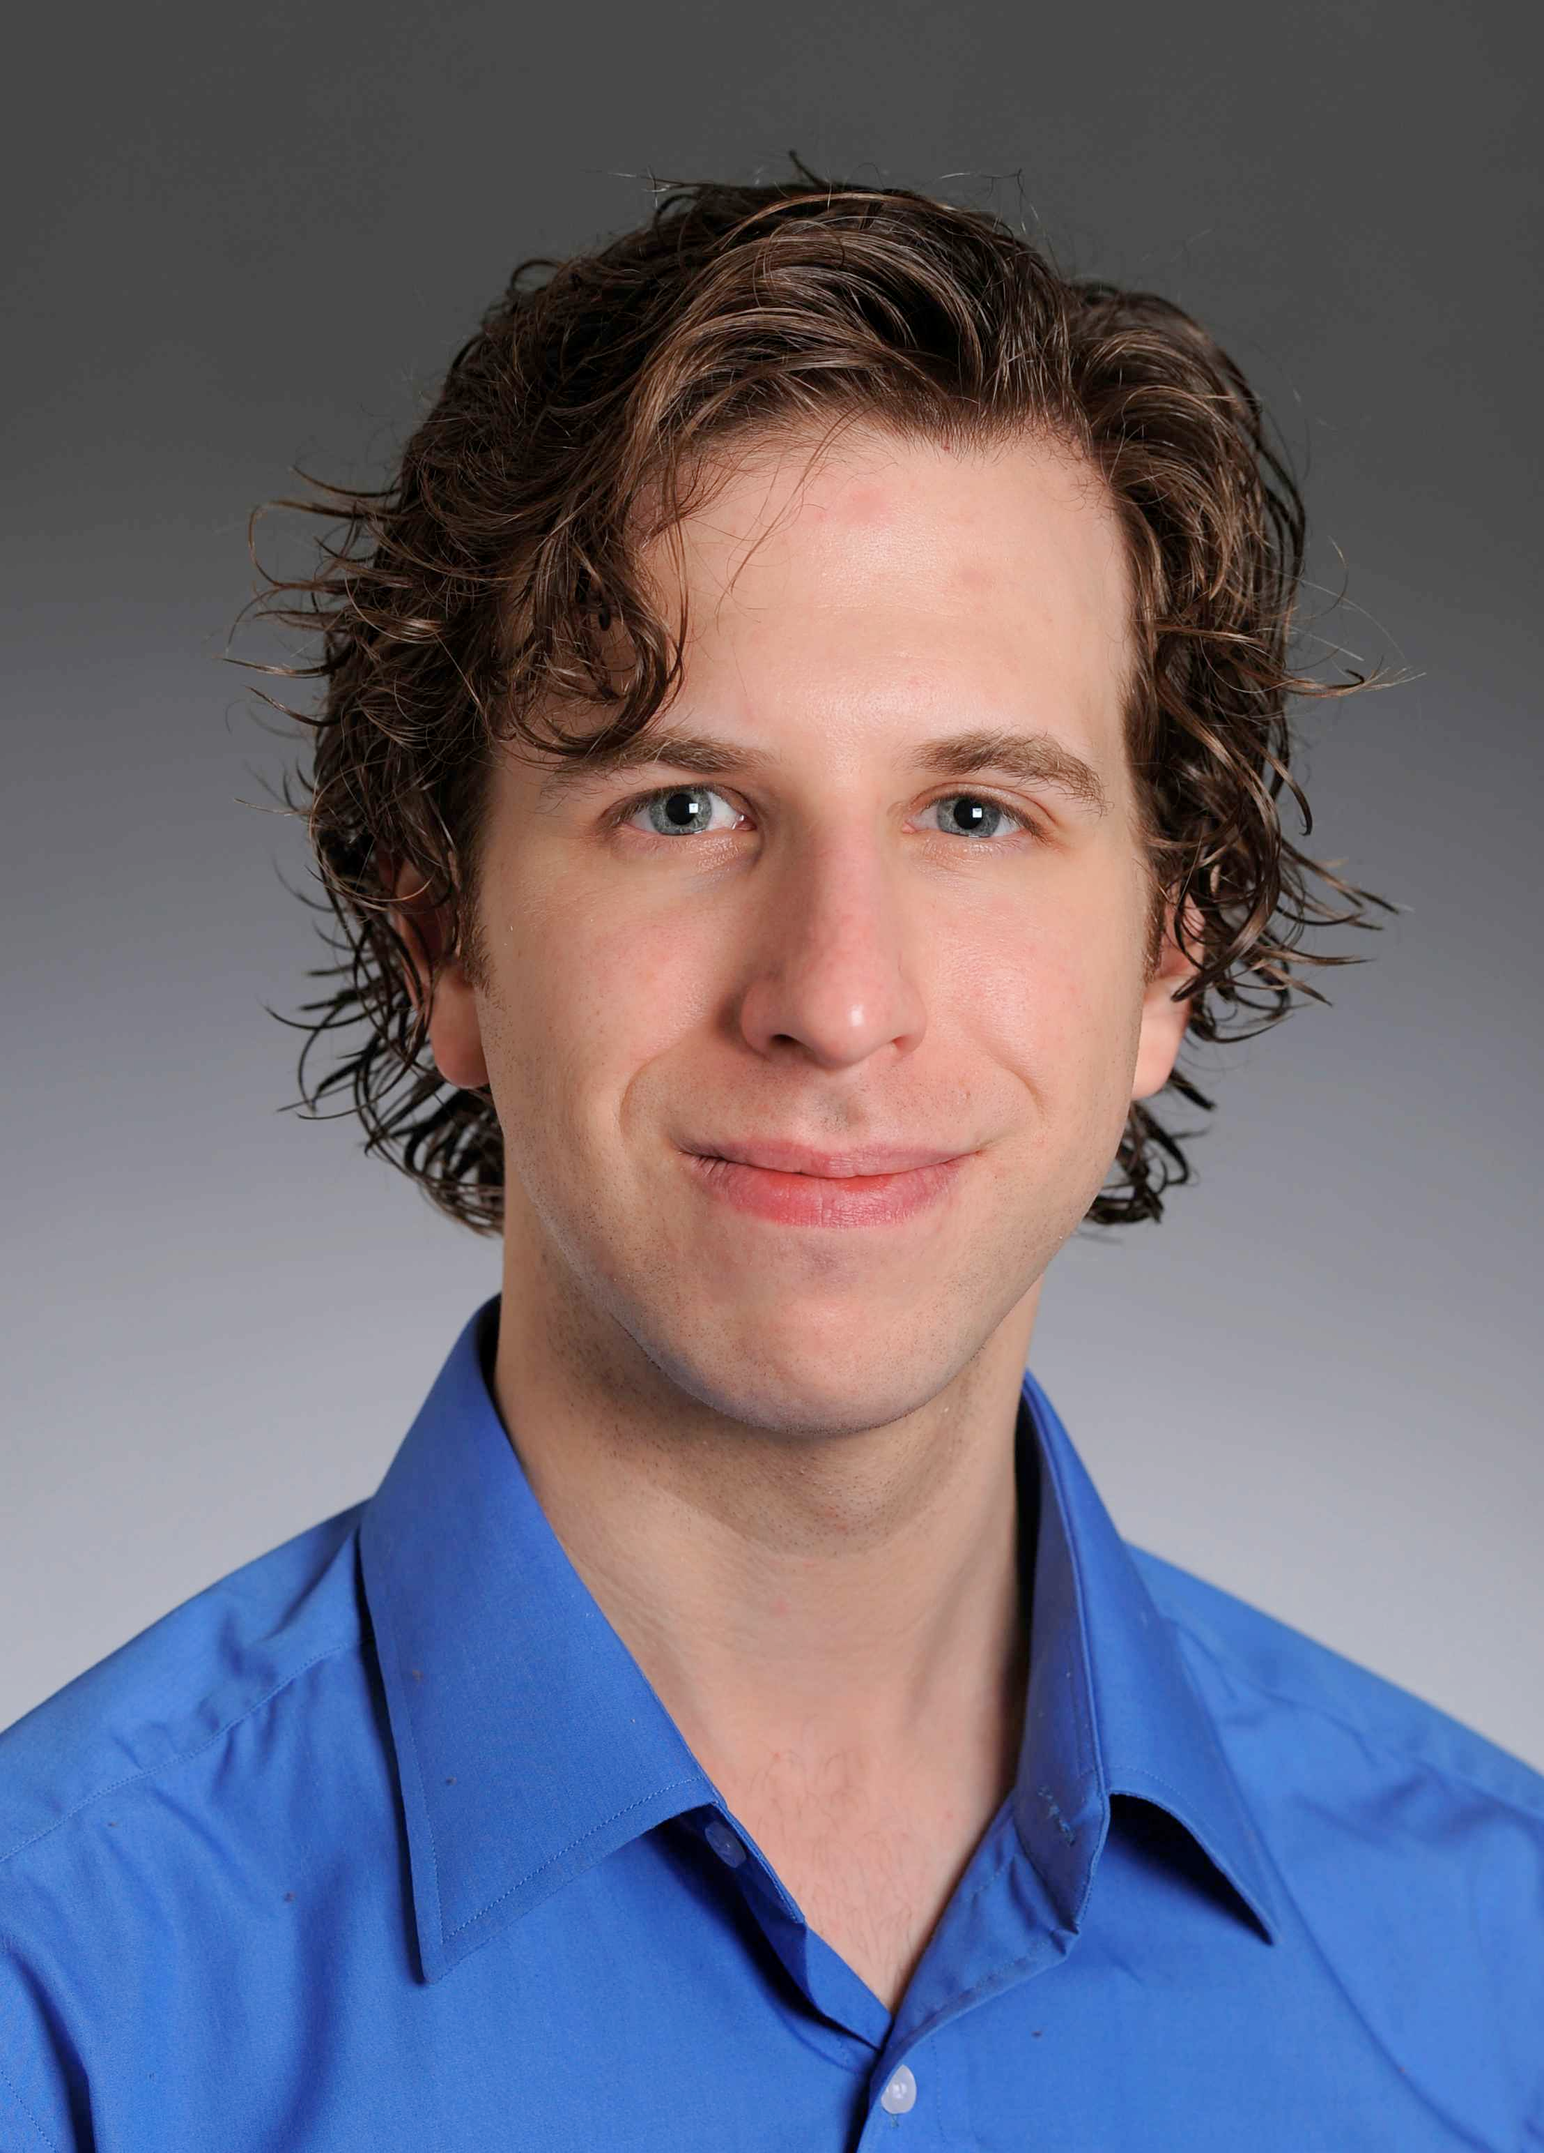
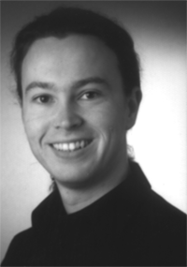
Beyond Keyword Search:
Representations and Models for Personalization
Khalid El-Arini
Thesis Defense – January 18, 2013
Thesis Committee:
Carlos Guestrin
U. of Washington
Zoubin Ghahramani
Cambridge/CMU
Tom Mitchell
CMU
Noah Smith
CMU
Thorsten Joachims
Cornell
TexPoint fonts used in EMF.
Read the TexPoint manual before you delete this box.: AA

Slide 2
personalization
Tailoring recommendations to the preferences of individual users

Slide 3

















Personalization is ubiquitous.

Slide 4
Personalization is invaluable.
Over 1 billion active users
400+ million tweets/day
Over 24 million goods offered
Keyword search is not enough

Slide 5

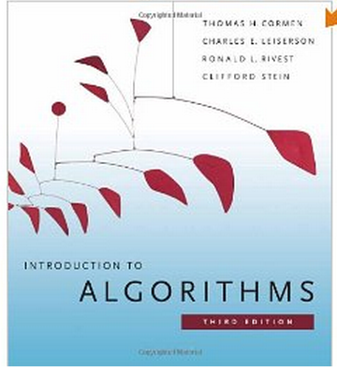
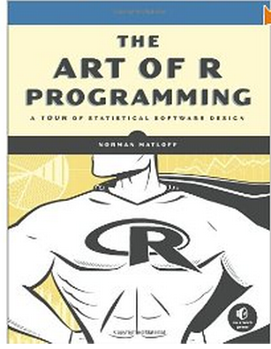

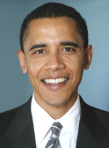

Challenges
cold start
redundancy
limited interaction
narrowly defined
content
| trust
opaque
Why am I getting this article?

Slide 6
In this thesis, we present a framework that effectively addresses each of these problems
Interactive Concept Coverage

Slide 7


Interactive Concept Coverage
Directly optimizes for diversity
  Minimizing redundancy is not post-processing
Rich user interactions encode complex user preferences
  User should express her information need in the most natural of ways
Interpretable representations of users and items
  Makes personalization more transparent
Generally applicable

Slide 8
Thesis Statement
In a variety of information overload settings,
the Interactive Concept Coverage framework produces personal recommendations
that are
  highly relevant
  diverse
  transparent
incorporating complex user preferences through rich user interaction.
Notes:
In a variety of information overload settings, the Interactive Concept Coverage framework produces personal recommendations that are highly relevant, diverse and transparent, incorporating complex user preferences through rich user interaction.

Slide 9
This talk
Part 1: Interactive Concept Coverage defined
Introduce via a simple example: news recommendation
Describe algorithms and theoretical guarantees
Show experimental results on real data
Produce a recipe for using our framework
Part 2: Complex information needs
Use recipe to successfully solve seemingly different problem:
discovering relevant scientific literature
Seamlessly incorporate complex queries and trust preferences
Part 3: Interpretable models and representations
More transparency, better performance
Part 4: Conclusions and future work

Slide 10
Part 1:
Interactive Concept Coverage defined
[El-Arini, Veda, Shahaf, Guestrin – KDD 2009]

Slide 11
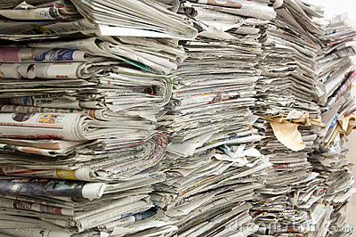

News recommendation
More than a million news articles and blog posts generated every hour*
Our task:
Election trouble
model
Songs of Syria
Sandy delays
Corpus of news articles
Recommendations
Success measure:
how many recommendations does the user like?
* [www.spinn3r.com]

Slide 12
Start with diversity
Why is it important?
  Redundancy leads to a bad user experience
Notes:
Users can get bored from redundancy
Putting all of our eggs in one basket
How do we optimize for this directly?

Slide 13


Start with diversity
Why is it important?
  Redundancy leads to a bad user experience
  Uncertainty around information need => don’t put all eggs in one basket
How do we optimize for diversity directly?
Notes:
Users can get bored from redundancy
Putting all of our eggs in one basket
How do we optimize for this directly?

Slide 14
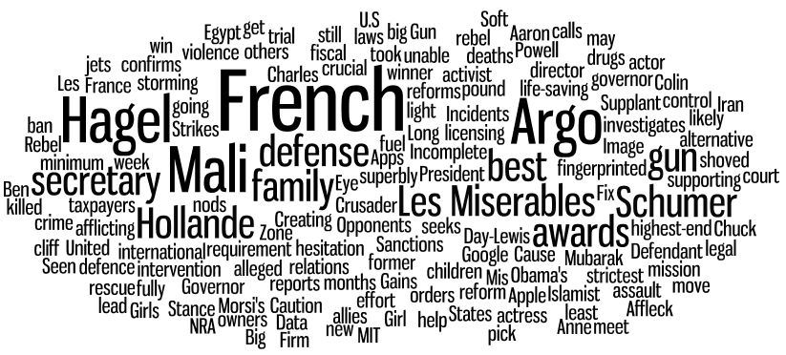
Covering the day’s news
France intervenes
Chuck for Defense
Argo wins big
Hagel expects fight
Monday, January 14, 2013
Notes:
And so, with this as motivation, our goal in this work is to Turn Down the Noise in the Blogosphere by presenting users with a small set of representative posts that cover the important stories. We refer to this as coverage.
<click>
For example, this is what a typical day looks like in the blogosphere. In this word cloud, the size of a word represents its frequency in the blogosphere for this day, January 17.
<click>
As we can see, the important features here are Obama, Israel – Gaza, New York, etc.

Slide 15
Covering the day’s news
France intervenes
Chuck for Defense
Argo wins big
New gun proposals
Monday, January 14, 2013
Notes:
And so, with this as motivation, our goal in this work is to Turn Down the Noise in the Blogosphere by presenting users with a small set of representative posts that cover the important stories. We refer to this as coverage.
<click>
For example, this is what a typical day looks like in the blogosphere. In this word cloud, the size of a word represents its frequency in the blogosphere for this day, January 17.
<click>
As we can see, the important features here are Obama, Israel – Gaza, New York, etc.

Slide 16
encode diversity as a
coverage problem

Slide 17

Classic MAX-COVER problem
What is being covered?
concepts
(here: named entities)
France
Mali
Hagel
Pentagon
Obama
Romney
Zero Dark Thirty
Argo
NFL
Hagel expects fight
Who is doing the covering?
articles

Slide 18
Classic MAX-COVER problem
Objective: pick k articles that cover the
most concepts
France
Mali
Hagel
Pentagon
Obama
Romney
Zero Dark Thirty
Argo
NFL
Enthusiasm for Inauguration wanes
Inauguration weekend
penalizes redundancy
concept importance?
concept weights
fast approx. algorithm
all-or-nothing too harsh

Slide 19
Our framework is based on a probabilistic extension of MAX-COVER

Slide 20
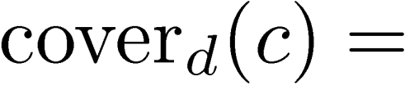
Probabilistic MAX-COVER
document coverage function
probability document d covers concept c
[e.g., unigram or topic model probability]
Obama
Romney
Enthusiasm for Inauguration wanes
Notes:
Previously, a set of docs A covered c if at least one of the docs in A contained c
Now we have a probabilistic notion of document covg, so we’ll define set covg in the analogous way.

Slide 21
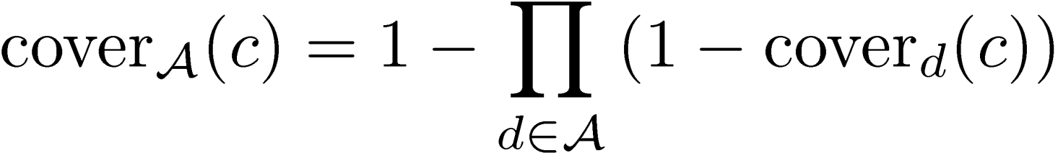
Probabilistic MAX-COVER
document coverage function
probability document d covers concept c
[e.g., unigram or topic model probability]
set coverage function
[probability that at least one document in A
covers concept c]
objective
concept weights
Notes:
Previously, a set of docs A covered c if at least one of the docs in A contained c
Now we have a probabilistic notion of document covg, so we’ll define set covg in the analogous way.

Slide 22
Optimization
Exact maximization is NP-hard

Slide 23
Optimization
Exact maximization is NP-hard
Our objective function is submodular
  Intuitive diminishing returns property
  Greedy algorithm leads to a (1 – 1/e) ~ 63% approximation, i.e., a near-optimal solution
  Efficient algorithm based on lazy computation (CELF) [Leskovec et al. 2007] makes optimization scalable
How well does this work?

Slide 24
Evaluating coverage
Evaluate on real blog data from Spinn3r
Two concept representations
  Fine-grained concepts (named entities, noun phrases)
  Coarse-grained concepts (LDA topics)
Conducted user study to evaluate:
topicality – how many articles are relevant to the important stories of the day?
redundancy – how many articles are redundant?
Notes:
[To gauge the performance of our approach,] We evaluate our approach on real blog data from a 2 week period in January. After pre-processing, we end up having around 200,000 posts per day.
<click>
We tested two variants of our algorithm. One algorithm used high level features and is labeled TDN+LDA, since the features used were topics from the Latent Dirichlet Allocation topic model. The other variant in which we used low level features is called TDN+NE, since the features used were nouns and named entities.
<click>
We did a user study with 27 participants, and used topicality and redundancy as our metrics for evaluation.

Slide 25
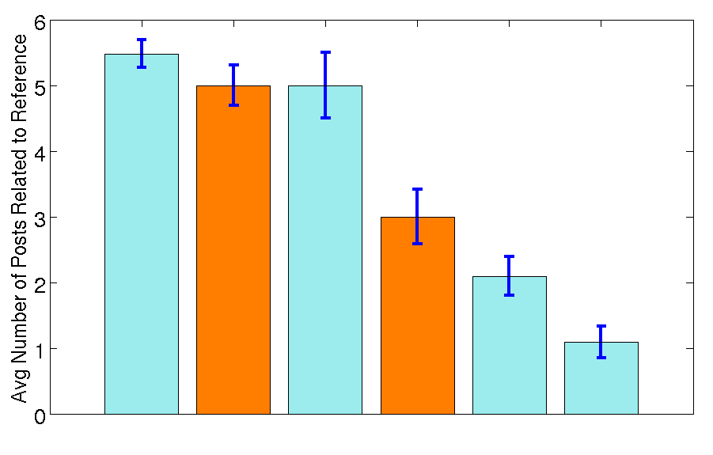




Results: Topicality
Higher is better
coarse
fine
our approach
Notes:
On this metric, Digg and Blogpulse perform poorly. Our approach is shown in orange.
<click>
Our algorithm using topics as features, performs as well as Google and Yahoo! Out of 10 posts, on an average about 5 posts selected by our algorithm are topical.

Slide 26
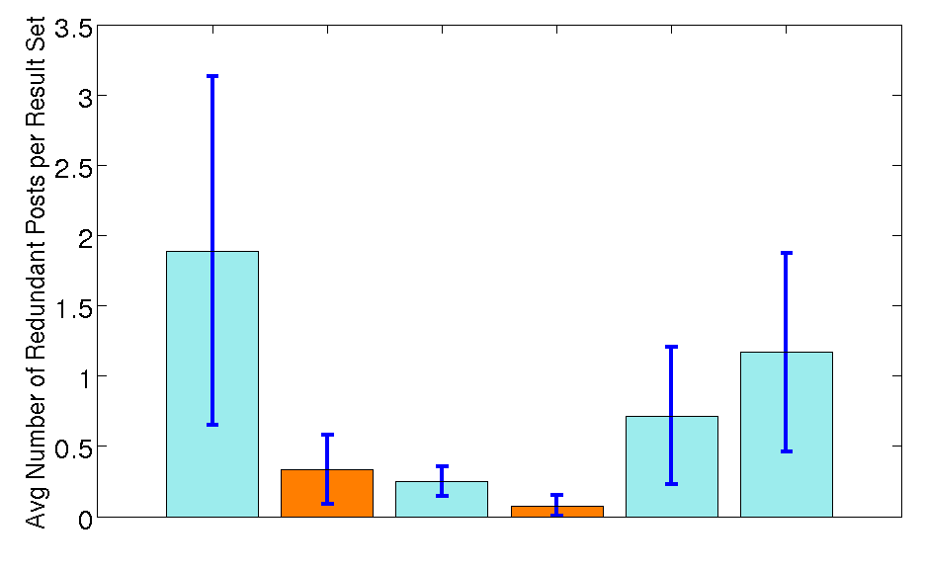
Results: Redundancy
Lower is better
coarse
fine
our approach
Notes:
Recall, we want low redundancy. Both variants of our approach achieve low redundancy, and on an average, less than one-half out of 10 posts selected by our algorithm are redundant.
<click>
On this metric, Google performs poorly, with about 2 posts out of 10 being redundant. We perform as well as Yahoo Buzz.

Slide 27
In the unpersonalized case, we produce relevant and diverse recommendations, comparable to Yahoo! and Google

Slide 28
But what about personalization?
Election trouble
model
Songs of Syria
Sandy delays
Recommendations

Slide 29
concept coverage
Assume same concept weighting for all users
France
Mali
Hagel
Pentagon
Obama
Romney
Zero Dark Thirty
Argo
NFL
France intervenes
Chuck for Defense
Argo wins big

Slide 30
Personal concept weights
Assume each user has different preference vector over concepts
France
Mali
Hagel
Pentagon
Obama
Romney
Zero Dark Thirty
Argo
NFL
politico
France
Mali
Hagel
Pentagon
Obama
Romney
Zero Dark Thirty
Argo
NFL
movie buff

Slide 31
Personal concept weights
Assume each user has different preference vector over concepts
Goal: Learn personal concept weights
from user feedback

Slide 32
interactive
concept coverage
France
Mali
Hagel
Pentagon
Obama
Romney
Zero Dark Thirty
Argo
NFL
France intervenes
Chuck for Defense
Argo wins big
Notes:
Describe two intuitions

Slide 33
Multiplicative Weights (MW)
We update our weights using simple, elegant Multiplicative Weights algorithm [Freund & Schapire, 1999]
Framing our problem as repeated matrix game allows us to prove a no-regret guarantee
Theorem Summary
On average, our online MW learner does no worse than an omniscient learner who picks the best, fixed weight vector w, in hindsight.

Slide 34
But how well does it do in practice?

Slide 35
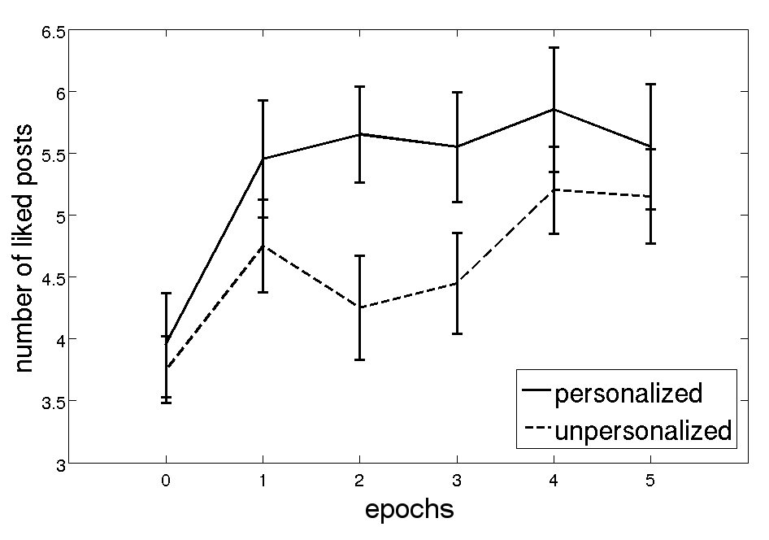
Personalization Evaluation
Personalized
Higher is better
Unpersonalized
Users prefer personalized posts
Notes:
It turns out that [as the number of personalization rounds increase,] on an average, users like personalized posts more than unpersonalized posts. Thus, based on this user study, we conclude that we are able to tailor post selection to users’ interests.

Slide 36
Interactive Concept Coverage
[this problem]
France
Mali
Hagel
Pentagon
Obama
Romney
Zero Dark Thirty
Argo
NFL
France intervenes
Chuck for Defense
Argo wins big

Slide 37
Interactive Concept Coverage
[general recipe]
Item 1
Item 2
Item 3

Slide 38
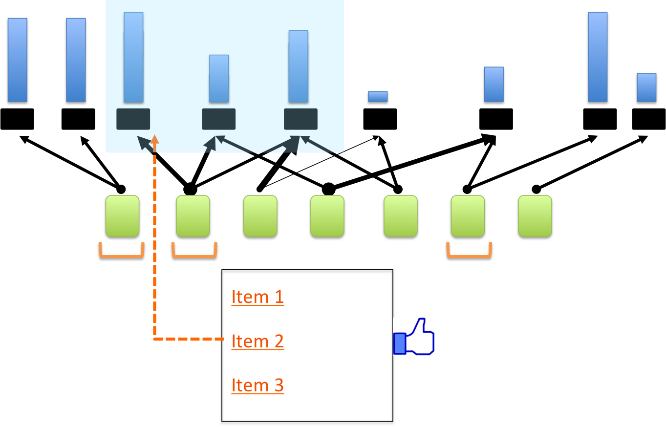
Interactive Concept Coverage
[general recipe]
Identify items to recommend from
Identify concepts [what makes items redundant?]
Weigh concepts by general importance
Define document coverage function
Select items using probabilistic MAX-COVER
Obtain feedback, update weights

Slide 39
Checkpoint
cold start
redundancy
limited interaction
narrowly defined
content | trust
opaque
Why am I getting this article?

Slide 40
Checkpoint
content-based
directly optimizes for diversity
limited interaction
narrowly defined
content | trust
opaque
Why am I getting this article?

Slide 41
This talk
Part 1: Interactive Concept Coverage defined
Introduce via a simple example: news recommendation
Describe algorithms and theoretical guarantees
Show experimental results on real data
Produce a recipe for using our framework
Part 2: Complex information needs
Use recipe to successfully solve seemingly different problem:
discovering relevant scientific literature
Seamlessly incorporate complex queries and trust preferences
Part 3: Interpretable models and representations
More transparency, better performance
Part 4: Conclusions and future work

Slide 42
Complex information needs
[El-Arini, Guestrin – KDD 2011]

Slide 43
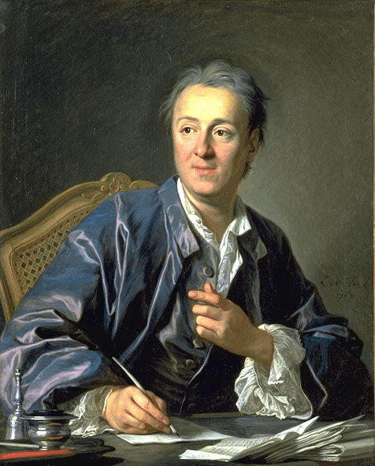
“It will be almost as convenient to search for some bit of truth concealed in nature as it will be to find it hidden away in an immense multitude of bound volumes.”
- Denis Diderot, 1755
Today:
10⁷ papers
10⁵ publications
[Thomson Reuters Web of Knowledge]

Slide 44
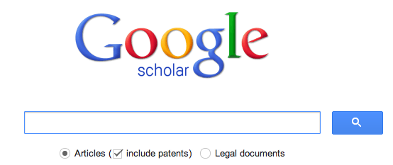

Our information need is
specific and complex.
Simple interaction
insufficient
Keywords not
expressive enough

Slide 45
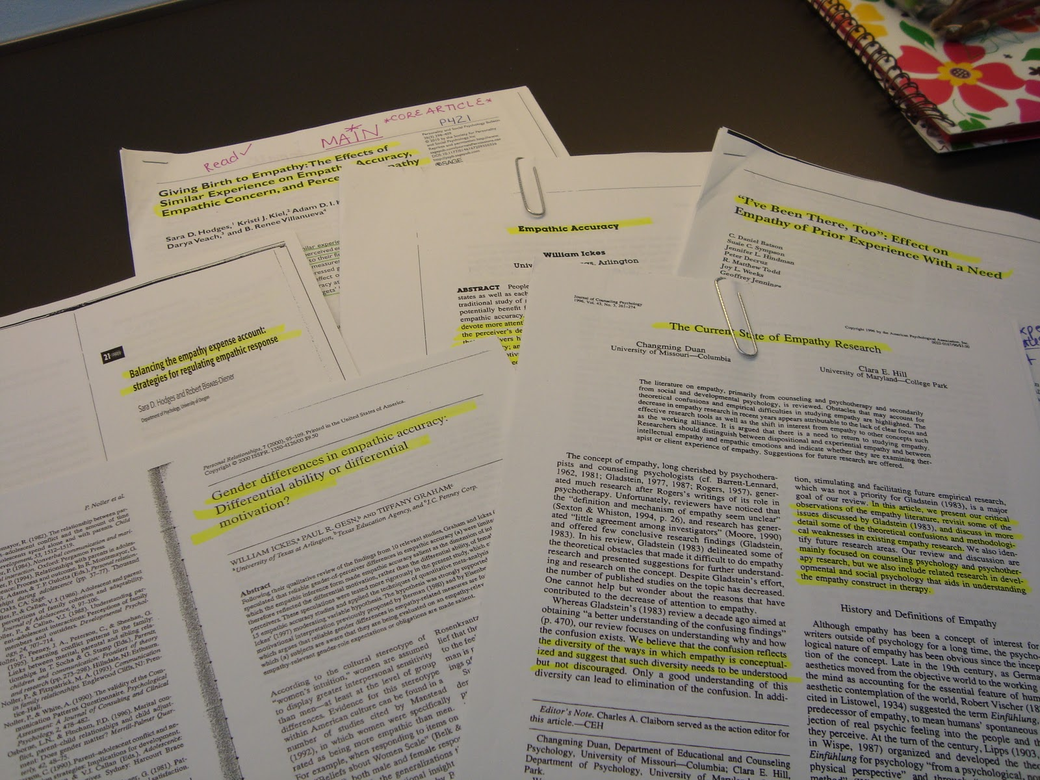
Given a set of relevant papers, what else should I read?

Slide 46
An example
seminal/background paper?
Cited by all
query papers
However, unlikely to find papers directly connected to entire query set.
We need something more general…
query set
Cites all
query papers
a competing approach?
Notes:
The query set

Slide 47
How do scientific papers
influence each other?

Slide 48

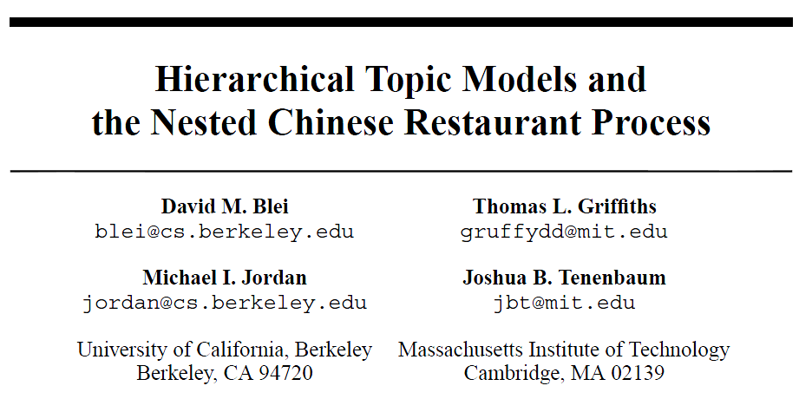
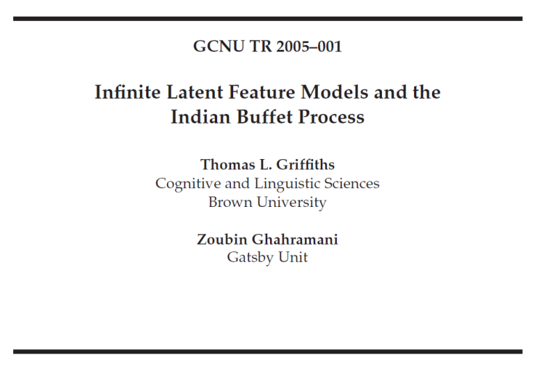
Modeling influence
Ideas flow from cited papers to citing papers

Slide 49
Influence context
Why do I cite this paper?
generative
variational
EM
…

Slide 50
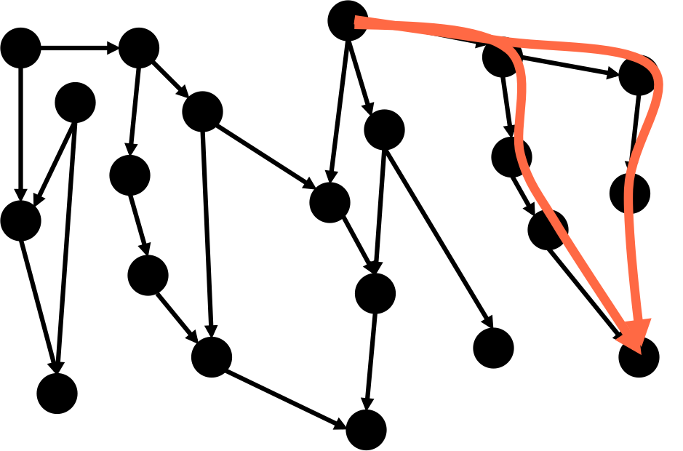
Using citation graph and article text, we define probabilistic notion of contextual influence
prob. of influence between x and y
with respect to word w
(cf. Chapter 4 of thesis and [El-Arini, Guestrin 2011])

Slide 51

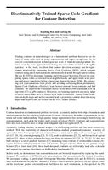
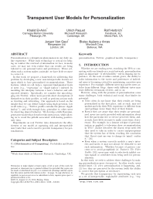
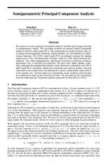
Our task:
Dynamic topic m…
Corpus of papers
model
Parallel coordina…
On basis pursuit
Recommendations
Query set
Select papers with strong influence to/from query set.

Slide 52
Interactive Concept Coverage
[general recipe]
Identify items to recommend from
Identify concepts [what makes items redundant?]
Weigh concepts by general importance
Define document coverage function
Select items using probabilistic MAX-COVER
Obtain feedback, update weights

Slide 53
Interactive Concept Coverage
[general recipe]
Identify items to recommend from

Slide 54
Interactive Concept Coverage
[general recipe]
Identify items to recommend from
Identify concepts [what makes items redundant?]
Articles redundant if influenced by the same query paper in the same way
“variational”

Slide 55
Interactive Concept Coverage
[general recipe]
Identify items to recommend from
Identify concepts [what makes items redundant?]
Articles redundant if influenced by the same query paper in the same way
concept = (query paper, word)

Slide 56
Interactive Concept Coverage
[general recipe]
Identify items to recommend from
Identify concepts [what makes items redundant?]
Weigh concepts by general importance
How often does “network” occur in this document?
( ,“nonparametric”)
( ,“variational”)
( ,“network”)
( ,“image”)

Slide 57
Interactive Concept Coverage
[general recipe]
Identify items to recommend from
Identify concepts [what makes items redundant?]
Weigh concepts by general importance
Define document coverage function

Slide 58
Interactive Concept Coverage
[general recipe]
Identify items to recommend from
Identify concepts [what makes items redundant?]
Weigh concepts by general importance
Define document coverage function
Select items using probabilistic MAX-COVER

Slide 59
How well does our framework solve this problem?

Slide 60
User Study Evaluation
PhD students in machine learning
Find related work to a recent paper
  Our technique
  Relational Topic Model [Chang, Blei 2010]
  Information Genealogy [Shaparenko, Joachims 2007]
  Google Scholar

Slide 61
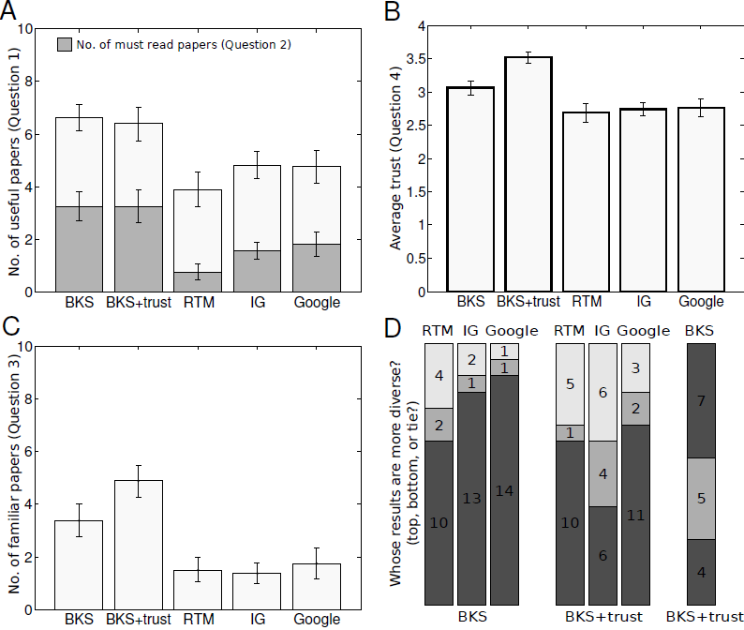
Usefulness
no. of “must read” papers
higher is better
ICC
Our approach provides more useful and
more must-read papers

Slide 62
For the same query, should all users get the same results?

Slide 63
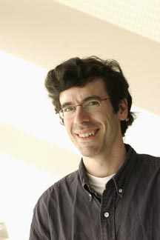
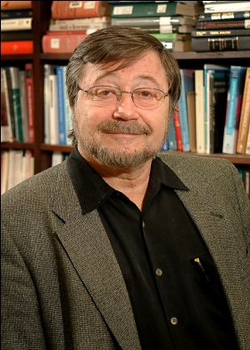
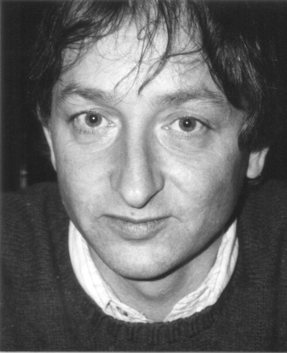
Which scientist comes to mind when you hear the word network?
Pearl
Kleinberg
Hinton
Bayesian
Social
Neural
trust preferences

Slide 64



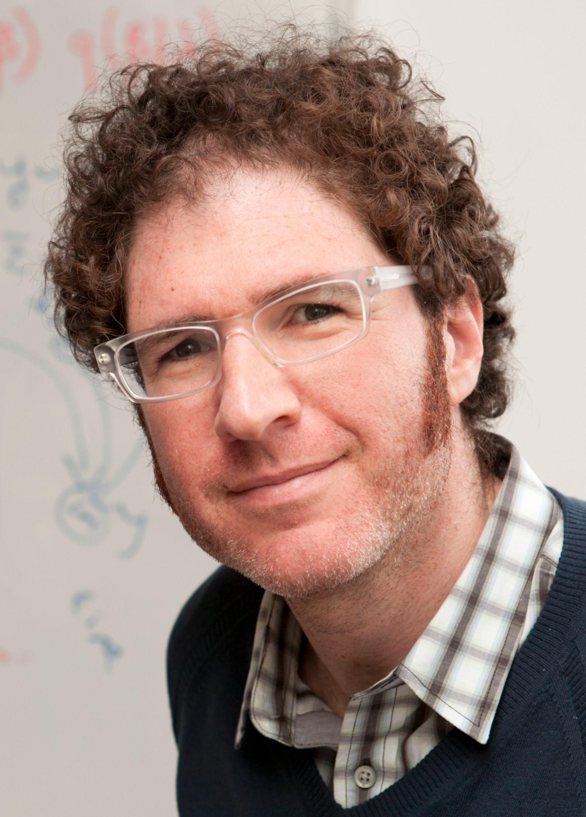
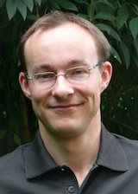
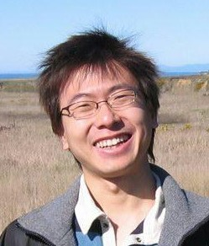
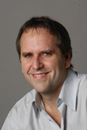
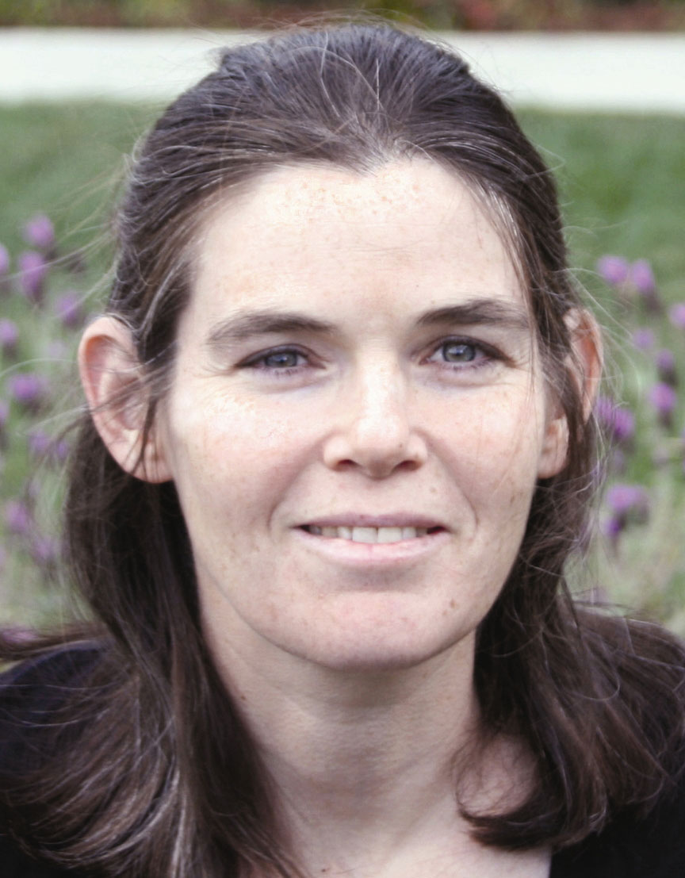
Specifying trust preferences
Simple
Non-exhaustive
Some of the venues I trust:
Some of the authors I trust:

Slide 65
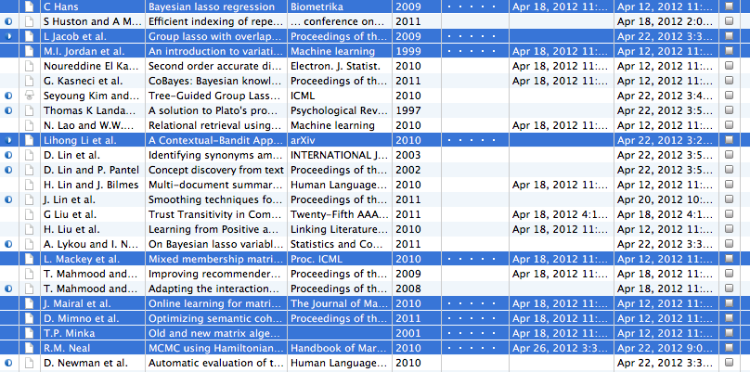
Specifying trust preferences
Simple
Non-exhaustive
Some of the papers I trust:
T

Slide 66
Given that you trust T,
how much do you trust
each author
with respect to
each word?

Slide 67
Computing trust
How much do I trust Jon Kleinberg with respect to the word “network”?
Kleinberg’s papers
An author is trusted if he/she influences the user’s trusted set T
T

Slide 68
How do we personalize for trust?
Redefine document coverage.

Slide 69
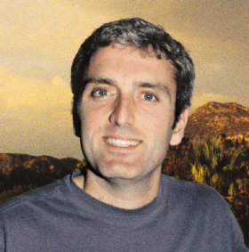
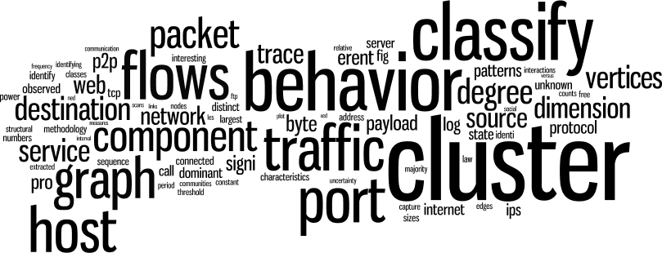
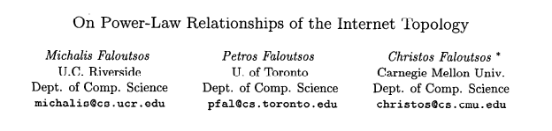
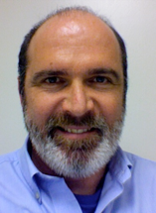
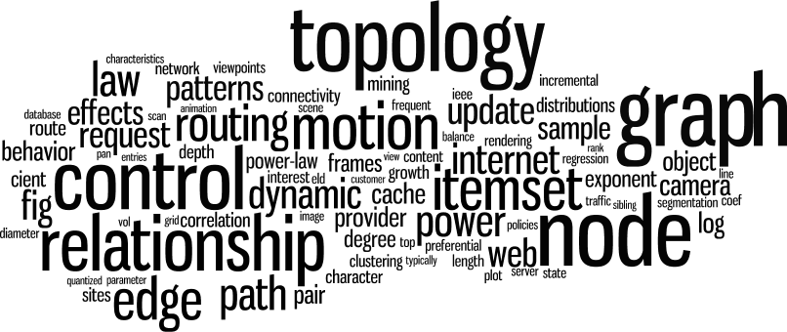
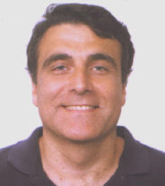
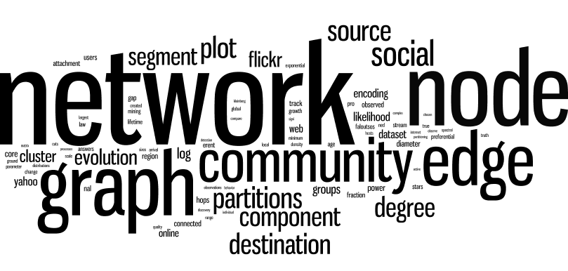
networks
graphics
data mining

Slide 70
Evaluating trust
higher is better
ICC
ICC+trust
Our approach provides more trustworthy papers

Slide 71
Diversity
Our approach produces more diverse results.

Slide 72
Checkpoint
content-based
directly optimizes for diversity
limited interaction
narrowly defined
content | trust
opaque
Why am I getting this article?

Slide 73
Checkpoint
content-based
directly optimizes for diversity
complex queries
narrowly defined
content | trust
opaque
Why am I getting this article?

Slide 74
Checkpoint
content-based
directly optimizes for diversity
complex queries
multi-dimensional preferences
content | trust
opaque
Why am I getting this article?

Slide 75
This talk
Part 1: Interactive Concept Coverage defined
Introduce via a simple example: news recommendation
Describe algorithms and theoretical guarantees
Show experimental results on real data
Produce a recipe for using our framework
Part 2: Complex information needs
Use recipe to successfully solve seemingly different problem:
discovering relevant scientific literature
Seamlessly incorporate complex queries and trust preferences
Part 3: Interpretable models and representations
More transparency, better performance
Part 4: Conclusions and future work

Slide 76
Interpretable models and representations
[El-Arini, Paquet, Herbrich, Van Gael, Agüera y Arcas – KDD 2012]
[El-Arini, Xu, Fox, Guestrin – in submission]

Slide 77


Transparent personalization
Why am I getting this?
73% of respondents: personalization is an “invasion of privacy”
[March 9, 2012]

Slide 78
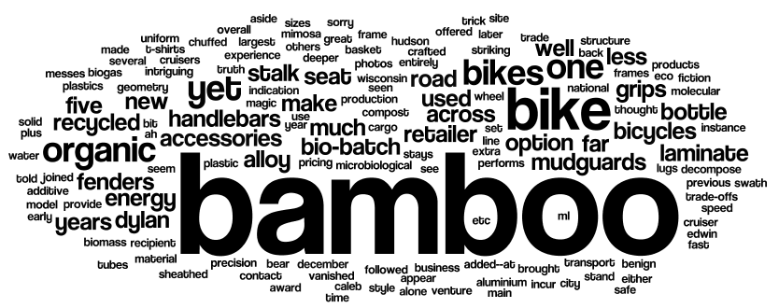
Transparent personalization
Why am I getting this?
Only as interpretable as underlying document representation
words
too specific

Slide 79
Transparent personalization
Why am I getting this?
Only as interpretable as underlying document representation
not directly interpretable
LDA topics
inconsistent across time

Slide 80
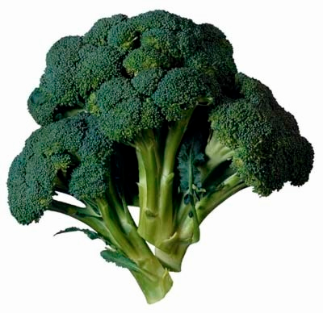

Transparent personalization
Why am I getting this?
Only as interpretable as underlying document representation
a better explanation
This article is recommended for
vegan
hipsters

Slide 81
We will represent documents by attributes of their likely readers
vegan
hipster
Badges

Slide 82

Key idea
Find a setting where users:
  Describe themselves (e.g., in a profile, on a personal website, etc.)
  Express interest in documents (e.g., by liking, sharing, etc.)
Associate labels users give themselves with the words in the documents they read

Slide 83
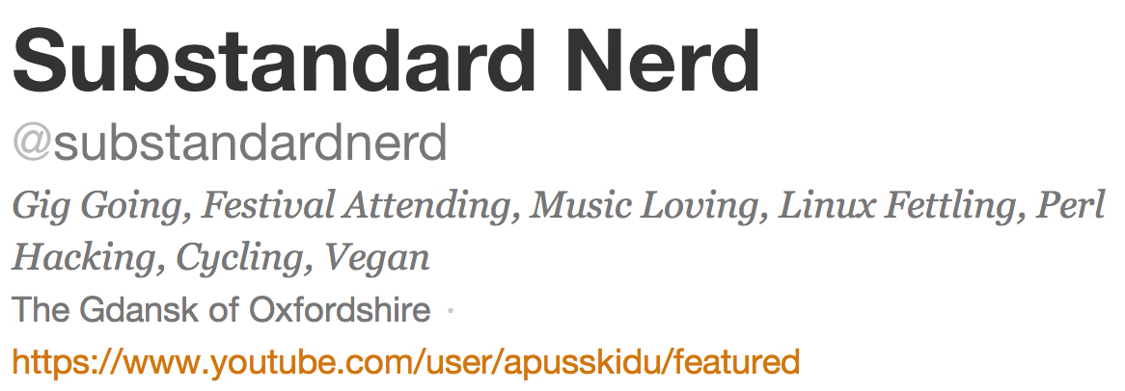
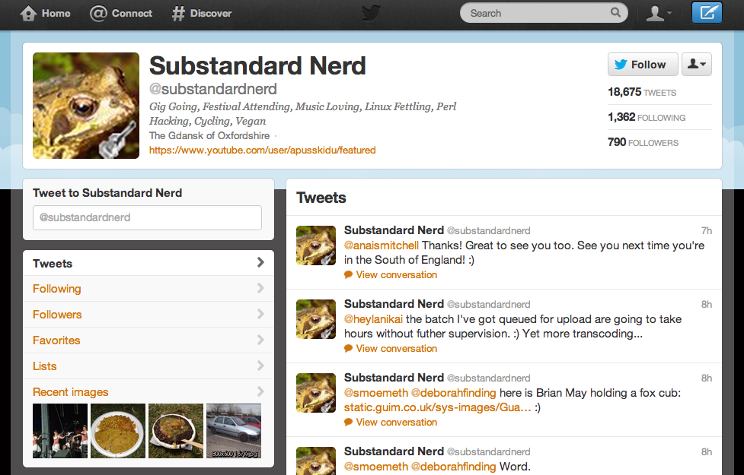
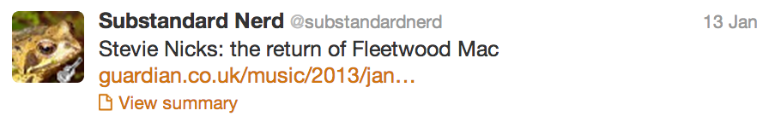
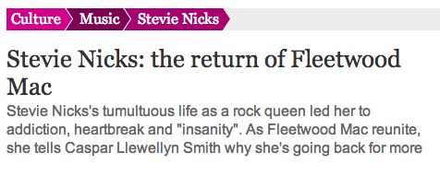

Slide 84
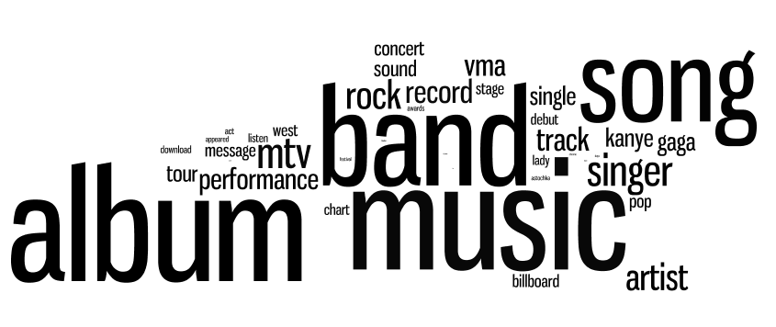
From many such tweets, we learn that someone who identifies with
music
reads articles with these words:

Slide 85
Badges as concepts
Interpretable
  Clear labels
  Correspond to user interests

Slide 86
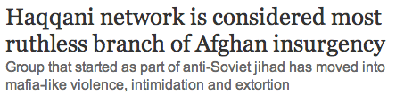


Badges as concepts
Interpretable
  Clear labels
  Correspond to user interests
Higher-level than words

Slide 87
Badges as concepts
Interpretable
  Clear labels
  Correspond to user interests
Higher-level than words
Semantically consistent over time
  No awkward matching necessary
  Politics changes over time, but the “politics” badge is still there to explain it

Slide 88
Our approach
Given: training set of tweeted news articles from a specific period of time
1. Learn a badge dictionary from training set
2. Use badge dictionary to sparsely code new
documents
music
words
badges

Slide 89
Learning the dictionary
Training data:
Bag-of-words representation of document
Identifies badges in Twitter profile of tweeter
album
Fleetwood Mac
love
Nicks
gig
music
cycling
linux

Slide 90
Learning the dictionary
Training data:
Model:
Bag-of-words representation of document
Identifies badges in Twitter profile of tweeter
V x 1
K x 1
V x K
sparse, non-negative dictionary

Slide 91
Learning the dictionary
Optimization
Efficiently solve via projected stochastic gradient descent, allowing us to operate on streaming data

Slide 92




Examining B
music
Biden
soccer
Labour
Notes:
Music
Soccer
Labour
Biden
tennis

Slide 93

Badges over time
music
Biden
September 2012
September 2010
Notes:
Music
Soccer
Labour
Biden
tennis

Slide 94


Dueling badges
progressive – TCOT
TCOT– progressive
July 2012

Slide 95
Coding the documents
Can we just re-use our objective, but fix B?
Problem case:
  Two articles about Barack Obama playing basketball
  Lasso problem arbitrarily codes one as {Obama, sports} and the other as {politics, basketball}
  No incentive to pick both “Obama” and “politics” (or both “sports” and “basketball”), as they cover similar words
  Leads to extremely related articles being totally dissimilar
How do we fix this?

Slide 96
A better coding
Problem occurs because vanilla lasso ignores relationships between badges
Idea: use badge co-occurrence statistics from Twitter

Slide 97
A better coding
Problem occurs because vanilla lasso ignores relationships between badges
Idea: use badge co-occurrence statistics from Twitter
Define weight γ_{s,t} to be high for badges that co-occur often in Twitter profiles
Graph-guided fused lasso [Kim, Sohn, Xing 2009]

Slide 98
Experimental results
Case study on political columnists
User study
Offline metrics

Slide 99


Coding columnists
Downloaded articles from July 2012 for fourteen prominent political columnists
Coded the articles via badge dictionary learned from same month
Nicholas Kristof
Maureen Dowd

Slide 100
A spectrum of pundits
“top conservatives on Twitter”
Limit dictionary to progressive and TCOT badges
Can we predict political alignments of the likely readers of each pundit?
more conservative

Slide 101
Experimental results
Case study on political columnists
User study
Offline metrics
User study shows badges better concept representation for ICC than LDA topics or tf-idf, when recommending news articles across time
Offline analysis shows badges are more thematically coherent than LDA topics

Slide 102
User study
The fundamental question:
  If we use badges as a concept representation, can we better capture user preferences?
Study on Amazon Mechanical Turk with 112 users
Steps:
  Show users random 20 articles from Guardian, from time period 1, and obtain ratings
  Pick random concept representation (tfidf, LDA, badges)
  Represent user preferences as mean of liked articles
  Use probabilistic max-cover to select 10 related articles from a second time period

Slide 103

User study

Slide 104
Checkpoint
content-based
directly optimizes for diversity
complex queries
multi-dimensional preferences
content | trust
opaque
Why am I getting this article?

Slide 105
Checkpoint
content-based
directly optimizes for diversity
complex queries
multi-dimensional preferences
content | trust
interpretablity
Why am I getting this article?

Slide 106
This talk
Part 1: Interactive Concept Coverage defined
Introduce via a simple example: news recommendation
Describe algorithms and theoretical guarantees
Show experimental results on real data
Produce a recipe for using our framework
Part 2: Complex information needs
Use recipe to successfully solve seemingly different problem:
discovering relevant scientific literature
Seamlessly incorporate complex queries and trust preferences
Part 3: Interpretable models and representations
More transparency, better performance
Part 4: Conclusions and future work

Slide 107
Thesis Statement
In a variety of information overload settings,
the Interactive Concept Coverage framework produces personal recommendations
that are
  highly relevant
  diverse
  transparent
incorporating complex user preferences through rich user interaction.
Notes:
In a variety of information overload settings, the Interactive Concept Coverage framework produces personal recommendations that are highly relevant, diverse and transparent, incorporating complex user preferences through rich user interaction.

Slide 108
Contributions
Interactive Concept Coverage: a general framework for personalized information retrieval
  Theoretical guarantees
    Near-optimal optimization
    No-regret preference learning
  State-of-the-art performance in two domains
    News recommendation
    Scientific literature discovery
  Addresses common challenges of personalization
Steps towards transparent personalization
  Interpretable document representation based on self-described attributes of likely readers => badges
  Transparent user models learned from Twitter activity
(cf. Chapter 5 and [El-Arini et al., 2012])

Slide 109
Future work
Interactive Concept Coverage beyond text
  Apply the general recipe to images, videos, music
Automatic fact-checking of the Web
  Bring our ideas of trust from research literature to web sites
Modeling the knowledge remainder
  In personalized settings, users wonder what they’re missing
  How can we model this and present to user?
Given my trusted sources, how likely is this true?
Notes:
Obama Biden Romney Boehner Cantor Bloomberg McConnell Reid

Slide 110










Thank You!
and Select Lab, family and friends
Notes:
Yisong
Ralf
Ulrich
Jurgen
Blaise
Chong
Brendan

